Slide 1
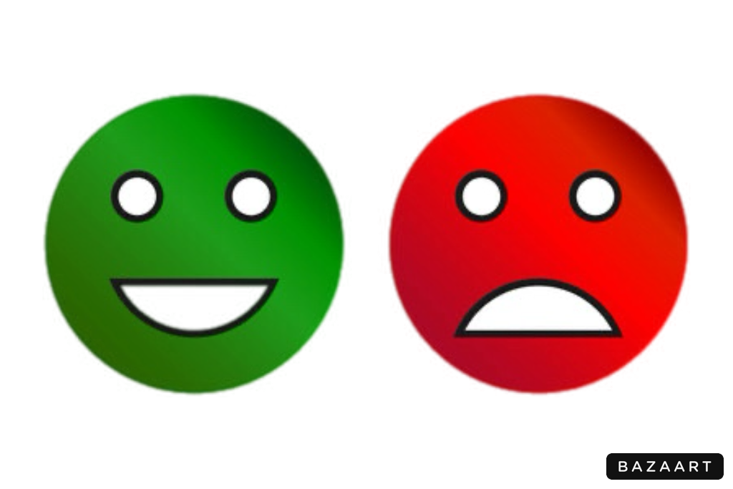
Sentiment Analysis Project
This project focuses on creating a machine learning model capable of determining the sentiment(positive or negative) of textual reviews.

Slide 2
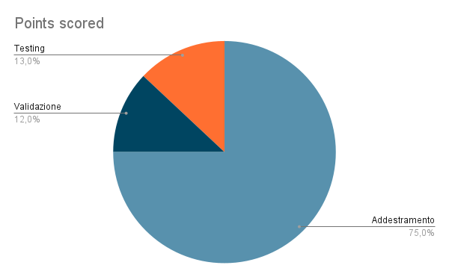
Data Collection and Preparation
Dataset splitted in 3 portions:
1. Training
2. Validation
3. Testing
text_cleaning.py
1.def expand_contractions(...)
2. def clean_text(text)

Slide 3
Tokenization e Padding
Tokenization
Split text in token, later on each token is converted in number. We obtain numerical token.
Padding
Add 0 to shorter sequences so that all ones have same length.
sentences = [ “Questo è un film fantastico”, “Non mi è piaciuto questo film”]
padded = [[1,2,3,0],[4,5,1,2]]
Word Index = {‘questo’:1, ‘film’: 2, ‘fantastico’:3, ‘non’:4, ‘piaciuto’:5}
Sequenza = [[1,2,3], [4,5,1,2]]

Slide 4
Creation and Model Architecture
Model Architecture: creation of the model using embedding, convolution, pooling and dense layers;
Model compilation, using the optimizer Adam;
Model Training, using training data and checkpoints;
Model evaluation, using validation data.
1
2
3
4

Slide 5
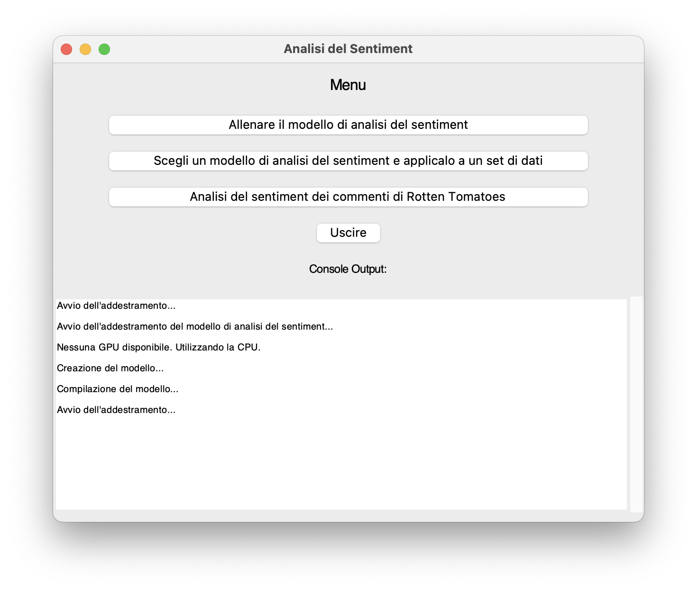
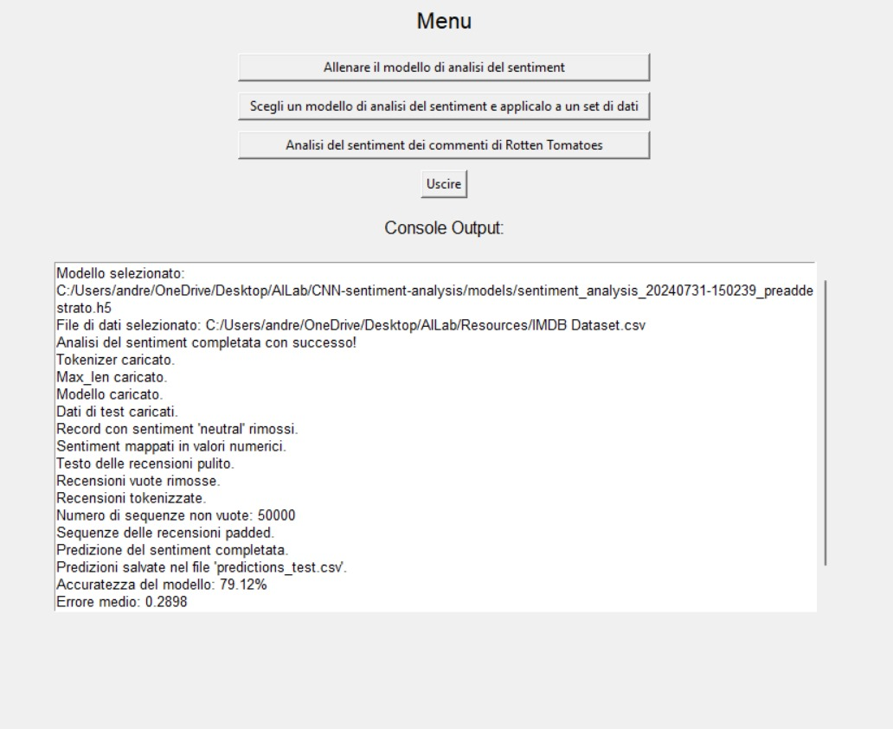
Model Application to dataset
GUI during the training session.
GUI during the applying session on Dataset.

Slide 6
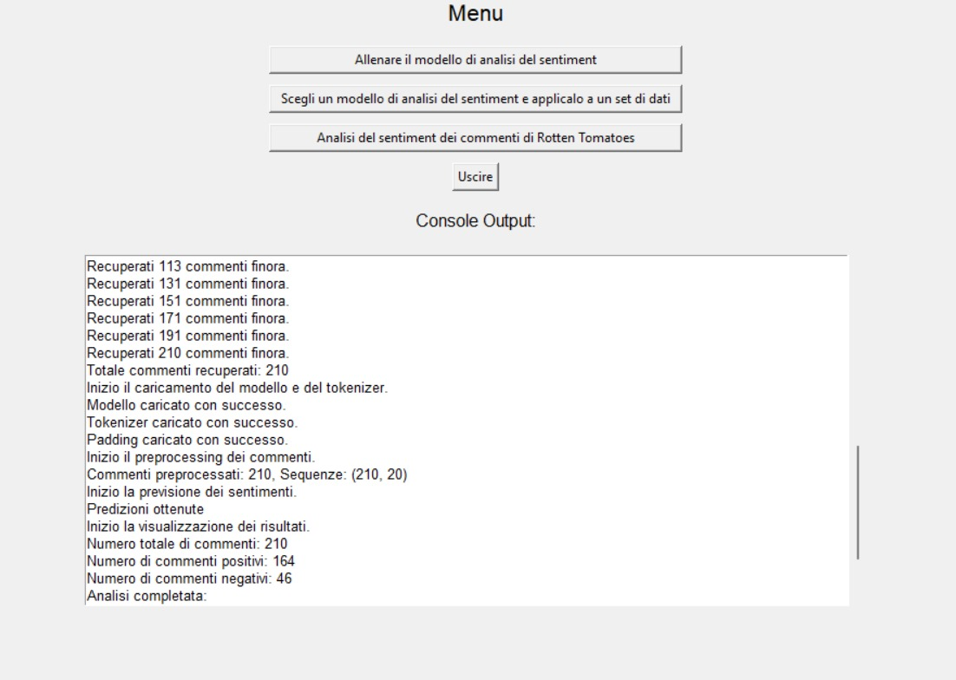
Model application to rotten tomatoes reviews
To test the actual functioning of our work we have implemented a scraping function, so if the URL of a web page of reviews is passed we can collect and analyze them.

Slide 7
Conclusions
Through machine learning, understanding and analyzing opinions is simplified and made accessible to anyone with the ability to quickly process large volumes of text data.
Speed
Accuracy
Scalability

